Slide 1
Bayesian Data Mining
University of Belgrade
School of Electrical Engineering
Department of Computer Engineering and Information Theory

Slide 2
Data Mining problem
Too many attributes in training set (colons of table)
Existing algorithms need too much time to find solution
We need to classify, estimate, predict in real time
Target | Value 1 | Value 2 | . . . |  |  |  |  |  | Value 100000

Slide 3
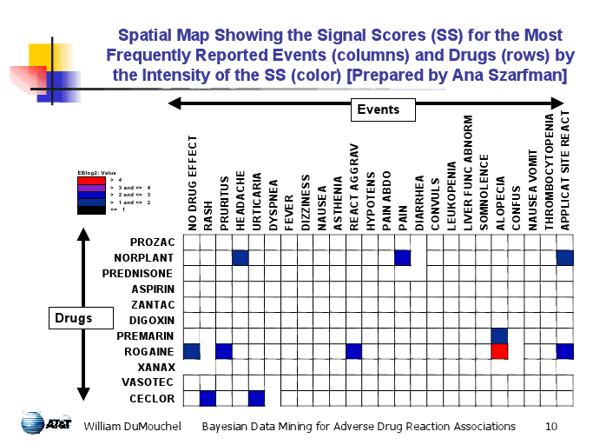
Problem importance
Find relation between:
All Diseases,
All Medications,
All Symptoms,

Slide 4
Existing solutions
CART, C4.5
Too many iterations
Continuous arguments need binning
Rule induction
Continuous arguments need binning
Neural networks
High computational time
K-nearest neighbor
Output depends only on distance based close values

Slide 5
Naïve Bayes Algorithm
Classification, Estimation, Prediction
Used for large data set
Very easy to construct
Not using complicated iterative parameter estimations
Often does surprisingly well
May not be the best possible classifier
Robust, Fast, it can usually be relied on to

Slide 6
Naïve Bayes algorithm Reasoning
New information arrived
How to classify Target?
Target | Attribute 1 | Attribute 2 |  |  |  |  |  | Attribute n
… | … | … | .. | … | … | .. | .. | ..
.. |  |  |  |  |  |  | .. | ..
… |  |  |  |  |  |  | .. | …
Training Set
Target | Attribute 1 | Attribute 2 |  |  |  |  |  | Attribute n
 | a1 | a2 |  |  |  |  |  | an
Missing

Slide 7
Naïve Bayes algorithm Reasoning
Target can be one of discrete values: t1, t2, …, tn
How to calculate?
Did not helped very much?
Naïve Bayes assumes that A1…An are independent, So:

Slide 8

Naïve Bayes Discrete Target Example
 | Age | Income | Student | Credit | Target Buys Computer
1 | Youth | High | No | Fair | No
2 | Youth | High | No | Excellent | No
3 | Middle | High | No | Fair | Yes
4 | Senior | Medium | No | Fair | Yes
5 | Senior | Low | Yes | Fair | Yes
6 | Senior | Low | Yes | Excellent | No
7 | Middle | Low | Yes | Excellent | Yes
8 | Youth | Medium | No | Fair | No
9 | Youth | Low | Yes | Fair | Yes
10 | Senior | Medium | Yes | Fair | Yes
11 | Youth | Medium | Yes | Excellent | Yes
12 | Middle | Medium | No | Excellent | Yes
13 | Middle | High | Yes | Fair | Yes
14 | Senior | Medium | No | Excellent | No
Attributes = (Age=youth, Income=medium, Student=yes, Credit_rating=fair)
P(Attributes, Buys_Computer=Yes) =
P(Age=youth|Buys_Computer=yes) * P(Income=medium|Buys_Computer=yes) *
P(Student=yes|Buys_Computer=yes) * P(Credit_rating=fair|Buys_Computer=yes) * P(Buys_Computer=yes)
=2/9 * 4/9 * 6/9 * 6/9 * 9/14 = 0.028
Attributes = (Age=youth, Income=medium, Student=yes, Credit_rating=fair)
P(Attributes, Buys_Computer=No) = P(Age=youth|Buys_Computer=no) *
P(Income=medium|Buys_Computer=no) * P(Student=yes|Buys_Computer=no) *
P(Credit_rating=fair|Buys_Computer=no) * P(Buys_Computer=no)
=3/5 * 2/5 * 1/5 * 2/5 * 5/14 = 0.007

Slide 9
Naïve Bayes Discrete Target - Example
Attributes = (Age=youth, Income=medium, Student=yes, Credit_rating=fair)
Target = Buys_Computer = [Yes | No] ?
P(Attributes, Buys_Computer=Yes) =
P(Age=youth|Buys_Computer=yes) * P(Income=medium|Buys_Computer=yes) *
P(Student=yes|Buys_Computer=yes) * P(Credit_rating=fair|Buys_Computer=yes) * P(Buys_Computer=yes)
=2/9 * 4/9 * 6/9 * 6/9 * 9/14 = 0.028
P(Attributes, Buys_Computer=No) = P(Age=youth|Buys_Computer=no) *
P(Income=medium|Buys_Computer=no) * P(Student=yes|Buys_Computer=no) *
P(Credit_rating=fair|Buys_Computer=no) * P(Buys_Computer=no)
=3/5 * 2/5 * 1/5 * 2/5 * 5/14 = 0.007
⬄ P(Buys_Computer=Yes | Attributes) > P(Buys_Computer=No| Attributes)
Therefore, the naïve Bayesian classifier predicts Buys_Computer = Yes for previously given Attributes

Slide 10
Naïve Bayes Discrete Target – Spam filter
Attributes = Text Document = w1,w2,w3… Array of words
Target = Spam = [Yes | No] ?
- probability that the i-th word of a given document occurs in documents, in training set, that are classified as Spam
- probability that all words of document occur in Spam documents in training set

Slide 11
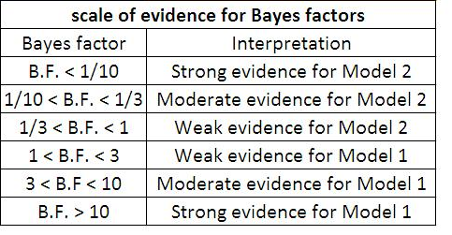
Naïve Bayes Discrete Target – Spam filter
- Bayes factor
Sample correction – if there is a word in document that never occurred in training set the whole will be zero.
Sample correction solution – put some low value for that

Slide 12
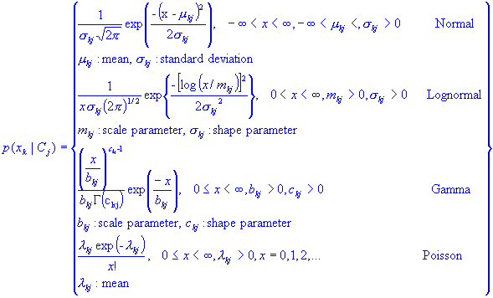
Gaussian Naïve Bayes Continuous Attributes
Continuous attributes do not need binning (like CART and C4.5)
Choose adequate PDF for each Attribute in training set
Gaussian PDF is most likely to be used to estimate the attribute probability density function (PDF)
Calculate PDF parameters by using Maximum Likelihood Method
Naïve Bayes assumption - each attribute is independent of other, so joint PDF of all attributes is result of multiplication of single attributes PDFs

Slide 13
Gaussian Naïve Bayes Continuous Attributes - Example
Training set
Validation set
sex | height (feet) | weight (lbs) | foot size (inches)
male | 6 | 180 | 12
male | 5.92 | 190 | 11
male | 5.58 | 170 | 12
male | 5.92 | 165 | 10
female | 5 | 100 | 6
female | 5.5 | 150 | 8
female | 5.42 | 130 | 7
female | 5.75 | 150 | 9
 | Target = male |  | Target = female
height (feet) | 5.885 | 0.027175 | 5.4175 | 0.07291875
weight (lbs) | 176.25 | 126.5625 | 132.5 | 418.75
foot size(inches) | 11.25 | 0.6875 | 7.5 | 1.25
sex | height (feet) | weight (lbs) | foot size (inches)
Target | 6 | 130 | 8

Slide 14
Naïve Bayes - Extensions
Easy to extend
Gaussian Bayes – sample of extension
Estimate Target – If Target is real number, but in training set has only few acceptable discrete values t1…tn, we can estimate Target by:
A large number of modifications have been introduced, by the statistical, data mining, machine learning, and pattern recognition communities, in an attempt to make it more flexible
Modifications are necessarily complications, which detract from its basic simplicity

Slide 15
Naïve Bayes - Extensions
Bayesian network
Are Attributes always really independent?
A1 = Weight, A2 = Height, A3 = Shoe Size, Target = [male|female]?
How can that influence our Naïve Bayes data mining?
Assumption
?

Slide 16
Bayesian Network
Bayesian network is a directed acyclic graph (DAG) with a probability table for each node.
Bayesian network contains: Nodes and Arcs between them
Nodes represent arguments from database
Arcs between nodes represent their probabilistic dependencies
A1
A4
A5
A7
Target
A6
P(A6|A4A5)
P(A2|Target)
A3
A2
P(A3|Target,A4A6)

Slide 17

Bayesian Network What to do
Construct Network
Training Set
Read Network
Naïve Bayes
Continue with naïve Bayes
Joint Probability
Distribution

Slide 18
Bayesian Network Read Network
Chain rule of probability
Bayesian network - Uses Markov Assumption
Joint Probability Distribution
A2
A5
A7
A7 depends only on A2 and A5

Slide 19
Bayesian Network Read Network - Example
M | T | P(B) | P(!B)
T | T | 0.95 | 0.05
T | F | 0.3 | 0.7
F | T | 0.6 | 0.4
F | F | 0.9 | 0.1
P(M) | P(!M)
0.2 | 0.8
P(T) | P(!T)
0.05 | 0.95
How to get P(N|B), P(B|M,T)?
Expert knowledge
From Data(relative frequency estimates)
Or a combination of both
Medication
Trauma
Blood Cloth
B | P(S) | P(!S)
T | 0.35 | 0.65
F | 0.1 | 0.9
Heart Attack
Nothing
Stroke
B | P(H) | P(!H)
T | 0.4 | 0.6
F | 0.15 | 0.85
B | P(N) | P(!N)
T | 0.25 | 0.75
F | 0.75 | 0.25

Slide 20
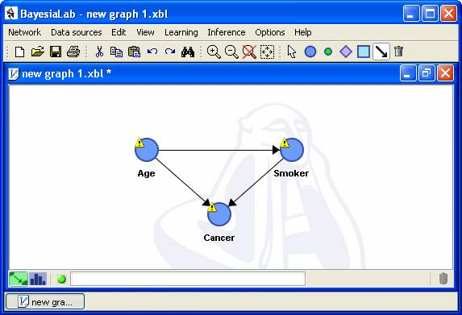
Bayesian Network Construct Network
Manually
From Database – Automatically
Heuristic algorithms
1. heuristic search method to construct a model
2.evaluates model using a scoring method
Bayesian scoring method
entropy based method
minimum description length method
3. go to 1 if score of new model is not significantly better
Algorithms that analyze dependency among nodes
Measure dependency by conditional independence (CI) test

Slide 21
Bayesian Network Construct Network
Heuristic algorithms
Advantages
less time complexity in worst case
Disadvantage
May not find the best solution due to heuristic nature
Algorithms that analyze dependency among nodes
Advantages
usually asymptotically correct
Disadvantage
CI tests with large condition-sets may be unreliable unless the volume of data is enormous.

Slide 22
Bayesian Network Construct Network - Example
1. Choose an ordering of variables X₁, … ,X_{n}
2. For i = 1 to n
add X_{i} to the network
select parents from X₁, … ,X_{i-1} such that P (X_{i} | Parents(X_{i})) = P (X_{i} | X₁, ... X_{i-1})
Marry Calls
John Calls
P(J | M) = P(J)?
No
P(A | J, M) = P(A | J)? P(A | J, M) = P(A)? No
P(B | A, J, M) = P(B | A)? Yes
P(B | A, J, M) = P(B)? No
P(E | B, A ,J, M) = P(E | A)? No
P(E | B, A, J, M) = P(E | A, B)? Yes
Alarm
Burglary
Earthquake

Slide 23
Create Network – from database d(Directional)-Separation
d-Separation is graphical criterion for deciding, from a given causal graph(DAG), whether a disjoint sets of nodes X-set, Y-set are independent, when we know realization of third Z-set
Z-set - is instantiated(values of it’s nodes are known) before we try to determine d-Separation(independence) between X-set and Y-set
X-set and Y-set are d-Separated by given Z-set if all paths between them are blocked
Example of Path : N1 <- N2 -> N3 -> N4 -> N5 <- N6 <- N7
N5 – “head-to-head” node
Path is not blocked if every “head-to-head” node is in Z-set or has descendant in Z-set, and all other nodes are not in Z-set.

Slide 24
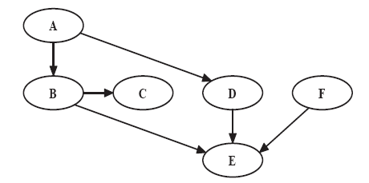
Create Network – from database d-Separation Example
3. Write down all pairs of nodes which are independent of each other.
Nodes which are independent are those that are d-separated by the empty set of nodes.
This means every path between them must contain at least one node with both path arrows going into it, which is E in current context.
We find that F is independent of A, of B, of C and of D. All other pairs of nodes are dependent on each other.
1. Does D d-separate C and F?
There are two undirected paths from C to F:
(i) C -B -E –F This blocked given D by the node E, since E is not one of the given nodes and has both arrows on the path going into it.
(ii) C - B - A - D - E - F. This path is also blocked by E (and D as well).
So, D does d-separate C and F
2. Do D and E d-separate C and F?
The path C - B - A - D - E - F is blocked by the node D given {D,E}.
However, E no longer blocks C - B - E - F path since it “given” node.
So, D and E do not d-separate C and F
4. Which pairs of nodes are independent of each other given B?
We need to find which nodes are d-separated by B.
A, C and D are all d-separated from F because of the node E.
C is d-separated from all the other nodes (except B) given B.
The independent pairs given B are hence: AF, AC, CD, CE, CF, DF.
5. Do we have that: P(AF|E) = P(A|E)P(F|E)? (are A and F independent given E?)
A and F are NOT independent given E, since E does not d-separate A and F

Slide 25
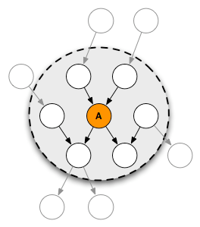
Create Network – from database Markov Blanket
MB(A) - set of nodes composed of A’s parents, its children and their other parents
When given MB(A) every other set of nodes in network is conditionally independent or d-Separated of A
MB(A) - The only knowledge needed
to predict the behavior of A – Pearl 1988.

Slide 26
Create Network – from database Conditional independence (CI) Test
Mutual information
Conditional mutual information
Used to quantify dependence between nodes X and Y
If we say that X and Y are d-Separated by condition set Z,
and that they are conditionally independent

Slide 27
Backup Slides
(Not needed)

Slide 28
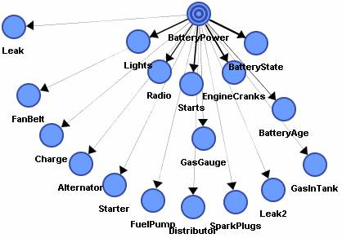
Create Network – from database Naïve Bayes
Very fast
Very robust
Target node is the father of all other nodes
The low number of probabilities to be estimated
Knowing the value of the target makes each node independent

Slide 29
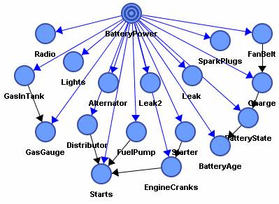
Create Network – from database Augmented Naïve Bayes
Naive structure + relations among son nodes | knowing the value of the target node
More precise results than with the naive architecture
Costs more in time
Models:
Pruned Naive Bayes
(Naive Bayes Build)
Simplified decision tree
(Single Feature Build)
Boosted (Multi Feature Build)

Slide 30
Create Network – from database Augmented Naïve Bayes
Tree Augmented Naive Bayes (TAN) Model
(a) Compute I(Ai, Aj|Target) between each pair of attributes, i≠j
(b) Build a complete undirected graph in which the vertices are the attributes A1, A2, …
The weight of an edge connecting Ai and Aj is I(Ai, Aj|Target)
(c) Build a maximum weighted spanning tree.
(d) Transform the resulting undirected tree to a directed one by choosing a root variable
and setting the direction of all edges to be outward from it.
(e) Construct a tree augmented naive Bayes model by adding a vertex labeled by C
and adding an directional edge from C to each Ai.

Slide 31
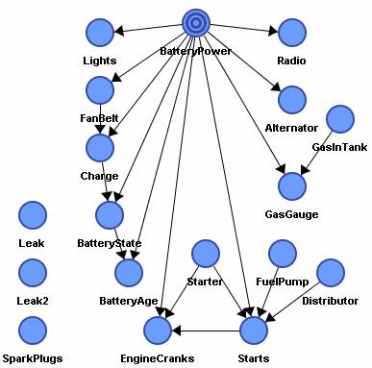
Create Network – from database Sons and Spouses
Target node is the father of a subset of nodes possibly having other relationships
Showing the set of nodes being indirectly linked to the target
Time cost of the same order as for the augmented naive Bayes

Slide 32
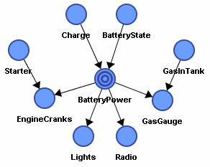
Create Network – from database Markov Blanket
Good tool for analyzing one variable
Searches for the nodes that belong to the Markov Blanket
The observation of the nodes belonging to the Markov Blanket makes the target node independent of all the other nodes.
Get relevant nodes on time frame lower than with the other two algorithms Augmented Naïve Bayes and Sons & Spouses

Slide 33
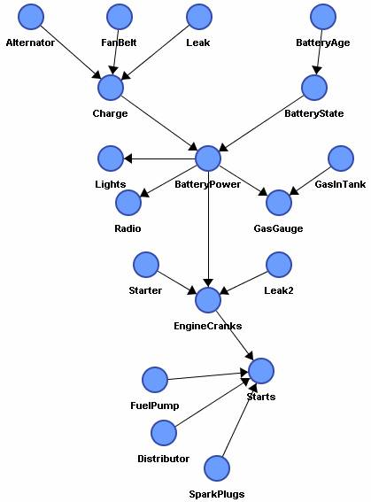
Create Network – from database Augmented Markov Blanket

Slide 34
Create Network – from database Construction Algorithm - Example
An Algorithm for Bayesian Belief Network Construction from Data
Jie Cheng, David A. Bell, Weiru Liu
School of Information and Software Engineering
University of Ulster at Jordanstown
Northern Ireland, UK, BT37 0QB
e-mail: {j.cheng, da.bell, w.liu}@ulst.ac.uk
Phase I: (Drafting)
1. Initiate a graph G(V, E) where V={all the nodes of a data set}, E={ }. Initiate two empty ordered set S, R.
2. For each pair of nodes (v , v ) i j where v v V i j , Î , compute mutual information I v v i j ( , ) using equation (1). For
the pairs of nodes that have mutual information greater than a certain small value e , sort them by their mutual
information from large to small and put them into an ordered set S.
3. Get the first two pairs of nodes in S and remove them from S. Add the corresponding arcs to E. (the direction of
the arcs in this algorithm is determined by the previously available nodes ordering.)
4. Get the first pair of nodes remained in S and remove it from S. If there is no open path between the two nodes
(these two nodes are d-separated given empty set), add the corresponding arc to E; Otherwise, add the pair of
nodes to the end of an ordered set R.
5. Repeat step 4 until S is empty.
Phase II: (Thickening)
6. Get the first pair of nodes in R and remove it from R.
7. Find a block set that blocks each open path between these two nodes by a set of minimum number of nodes.
(This procedure find_block_set (current graph, node1, node2) is given at the end of this subsection.)
Conduct a CI test. If these two nodes are still dependent on each other given the block set, connect them by an
arc.
8. go to step 6 until R is empty.
Phase III: (Thinning)
9. For each arc in E, if there are open paths between the two nodes besides this arc, remove this arc from E temporarily and call procedure find_block_set (current graph, node1, node2). Conduct a CI test on the condition of the block set. If the two nodes are dependent, add this arc back to E; otherwise remove the arc permanently.

Slide 35
Bayesian Network Applications
Applications
1. Gene regulatory networks
2. Protein structure
3. Diagnosis of illness
4. Document classification
5. Image processing
6. Data fusion
7. Decision support systems
8. Gathering data for deep space exploration
9. Artificial Intelligence
10. Prediction of weather
11. On a more familiar basis, Bayesian networks are used by the friendly Microsoft office assistant to elicit better search results.
12. Another use of Bayesian networks arises in the credit industry where an individual may be assigned a credit score based on age, salary, credit history, etc. This is fed to a Bayesian network which allows credit card companies to decide whether the person's credit score merits a favorable application.

Slide 36
Bayesian Network Advantages, Limits
The advantages of Bayesian Networks:
Visually represent all the relationships between the variables
Easy to recognize the dependence and independence between nodes.
Can handle incomplete data
scenarios where it is not practical to measure all variables (costs, not enough sensors, etc.)
Help to model noisy systems.
Can be used for any system model - from all known parameters to no known parameters.
The limitations of Bayesian Networks:
All branches must be calculated in order to calculate the probability of any one branch.
The quality of the results of the network depends on the quality of the prior beliefs or model.
Calculation can be NP-hard
Calculations and probabilities using Baye's rule and marginalization can become complex and are often characterized by subtle wording, and care must be taken to calculate them properly.

Slide 37


Bayesian Network Software
Bayesia Lab
Weka - Machine Learning Software in Java
AgenaRisk , Analytica, Banjo, Bassist, Bayda, BayesBuilder, Bayesware Discoverer , B-course, Belief net power constructor, BNT, BNJ, BucketElim, BUGS, Business Navigator 5, CABeN, Causal discoverer , CoCo+Xlisp, Cispace, DBNbox, Deal, DeriveIt, Ergo , GDAGsim, Genie, GMRFsim, GMTk, gR, Grappa, Hugin Expert, Hydra, Ideal, Java Bayes, KBaseAI, LibB, MIM, MSBNx, Netica, Optimal Reinsertion, PMT

Slide 38
Problem Trend
History
The term "Bayesian networks" was coined by Judea Pearl in 1985
In the late 1980s the seminal texts Probabilistic Reasoning in Intelligent Systems and Probabilistic Reasoning in Expert Systems summarized the properties of Bayesian networks
Fields of Expansion
Naïve Bayes
Choose optimal PDF
Bayesian Networks
Find new way to construct network

Slide 39
Bibliography – borrowed parts
Naïve Bayes Classifiers, Andrew W. Moore Professor School of Computer Science Carnegie Mellon University www.cs.cmu.edu/~awm awm@cs.cmu.edu 412-268-7599
http://en.wikipedia.org/wiki/Bayesian_network
Bayesian Measurement of Associations in Adverse Drug Reaction Databases William DuMouchel Shannon Laboratory, AT&T Labs –Research
dumouchel@research.att.com
DIMACS Tutorial on Statistical Surveillance Methods
Rutgers University
June 20, 2003
http://download.oracle.com/docs/cd/B13789_01/datamine.101/b10698/3predict.htm#1005771
CS/CNS/EE 155: Probabilistic Graphical Models Problem Set 2 Handed out: 21 Oct 2009 Due: 4 Nov 2009
Learning Bayesian Networks from Data: An Efficient Approach Based on Information Theory Jie Cheng Dept. of Computing Science University of Alberta Alberta, T6G 2H1 Email: jcheng@cs.ualberta.ca David Bell, Weiru Liu Faculty of Informatics, University of Ulster, UK BT37 0QB Email: {w.liu, da.bell}@ulst.ac.uk
http://www.bayesia.com/en/products/bayesialab/tutorial.php
ISyE8843A, Brani Vidakovic Handout 17 1 Bayesian Networks
Bayesian networks Chapter 14 Section 1 – 2
Naive-Bayes Classification Algorithm Lab4-NaiveBayes.pdf
Top 10 algorithms in data mining XindongWu · Vipin Kumar · J. Ross Quinlan · Joydeep Ghosh · Qiang Yang · Hiroshi Motoda · Geoffrey J. McLachlan · Angus Ng · Bing Liu · Philip S. Yu · Zhi-Hua Zhou · Michael Steinbach · David J. Hand · Dan Steinberg Received: 9 July 2007 / Revised: 28 September 2007 / Accepted: 8 October 2007 Published online: 4 December 2007 © Springer-Verlag London Limited 2007
Causality Computational Systems Biology Lab Arizona State University Michael Verdicchio With some slides and slide content from: Judea Pearl, Chitta Baral, Xin Zhang

Slide 40
Questions?

